Slide 1





E‑COMMERCE API BACKEND
BUILDING A HIGH‑PERFORMANCE E‑COMMERCE API

Slide 2

PROJECT GOAL
Objective: Design, implement, and deploy a secure, scalable, and efficient GraphQL API for an e‑commerce platform.
1
UNIFIED SCHEMA: SINGLE ENDPOINT FOR PRODUCTS, ORDERS, AND USERS.
2
HIGH PERFORMANCE: ELIMINATE N+1 QUERIES AND AVOID OVER‑FETCHING.
3
ROBUST FEATURES: FILTERING, PAGINATION, AND SORTING.
4
SECURITY: AUTHENTICATION AND ROLE‑BASED ACCESS CONTROL (RBAC).
5
REPRODUCIBILITY: FULLY CONTAINERIZED (DOCKER).

Slide 3

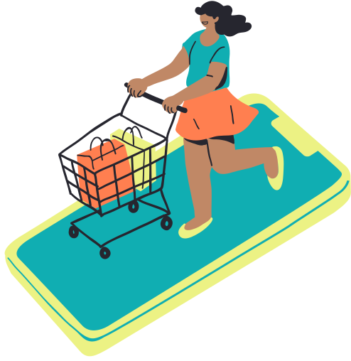


TECH STACK
  Server: Node.js + Express
  API Layer: Apollo Server (GraphQL)
  Database: MongoDB
  ODM: Mongoose (models & validation)
  Auth: JSON Web Tokens (JWT)
  Performance: DataLoader (batching/caching)
  Dev / Infra: Docker & Docker Compose

Slide 4

HIGH‑LEVEL ARCHITECTURE
  Client (React) sends a GraphQL query to http://localhost:4000.
  Apollo Server receives the request and invokes the context function.
  Context verifies JWT and attaches user and DataLoaders to the context.
  Resolvers execute and request data via DataLoader-enabled functions.
  Mongoose queries MongoDB (batched by DataLoader where applicable).
  A JSON response is returned to the client.

Slide 5
CORE SCHEMA DESIGN
Query
  products(filter, limit, offset): ProductConnection — paginated list
  product(id: ID!): Product — single product
  categories: [Category!]! — all categories
  myOrders: [Order!]! — orders for the authenticated user
Mutation
  register / login — returns JWT
  createProduct(input: CreateProductInput!): Product (Admin only)
  placeOrder(input: PlaceOrderInput!): Order (Authenticated users)

Slide 6


SOLVING THE N+1 PROBLEM
The problem: Request 10 products where each has a category — naive resolvers cause 1 query for products + 10 queries for categories.
The solution: DataLoader
How it works:
  Resolvers call context.loaders.category.load(categoryId) instead of running a DB query.
  DataLoader batches IDs from a single request tick and executes one Category.find({_id: {$in: [...]}}).
  Results are mapped back to each original request.
Result: 11 queries → 2 queries (one for products, one batched query for all categories).

Slide 7

AUTHENTICATION & AUTHORIZATION
1. Authentication (register / login)
  Client sends credentials; server verifies and signs a JWT containing { userId, role }.
  Client stores token (e.g., HTTP‑only cookie or secure storage).
2. Context function (per request)
  Reads Authorization: Bearer <token> header, verifies token, and attaches user and loaders to the context.
3. Authorization (resolver level)
  Resolvers inspect context.user.role and enforce RBAC.

Slide 8
LIVE DEMO
Demo steps:
  Show docker-compose.yml then run docker-compose up --build.
  Run npm run seed to populate sample data.
  Open Apollo Sandbox and run an example products query with filters.
  Perform register/login; paste JWT into HTTP headers.
  Run myOrders and placeOrder to demonstrate auth‑protected operations.

Slide 9


FUTURE IMPROVEMENTS
  Caching: Add @cacheControl hints and CDN caching for public endpoints.
  Real‑time updates: GraphQL Subscriptions for order status and inventory notifications.
  File uploads: Integrate image uploads to S3 (presigned URLs).
  Atomic transactions: Use Mongoose sessions in placeOrder for stock checks + order creation.
  Observability: Add structured logging, metrics, and distributed tracing (e.g., OpenTelemetry).

Slide 10

THANK YOU
QUESTIONS?

